Slide 1

Final Project
Disaster Tweets
Feiyu Zhang
fz114@scarletmail.rutgers.edu
Junyi Li
jl2707@scarletmail.rutgers.edu
Ziyu Zhou
zz544@scarletmail.rutgers.edu

Slide 2
01
Data Overview
02
Topic Modeling with LDA
CONTENTS
03
Feature Engineering
04
Sentimental Analysis
05
Model training

Slide 3
01
Data Overview

Slide 4
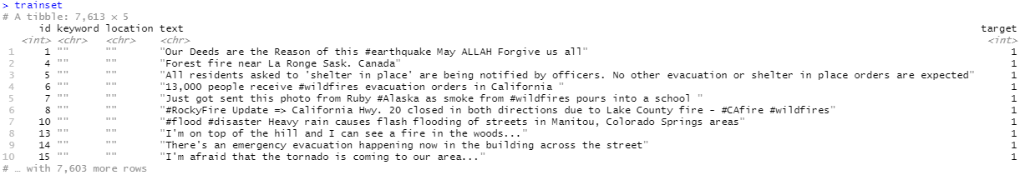
Dataset introduction
From Natural Language Processing with Disaster Tweets | Kaggle to get dataset train.csv and test.csv.
Columns:
id - a unique identifier for each tweet
text - the text of the tweet
location - the location the tweet was sent from (may be blank)
keyword - a particular keyword from the tweet (may be blank)
target (hand classified) - in train.csv only, this denotes whether a tweet is about a real disaster (1) or not (0)
正文内容，本段适应大段文字章节
04
3,263 rows(obs.) for test set

Slide 5
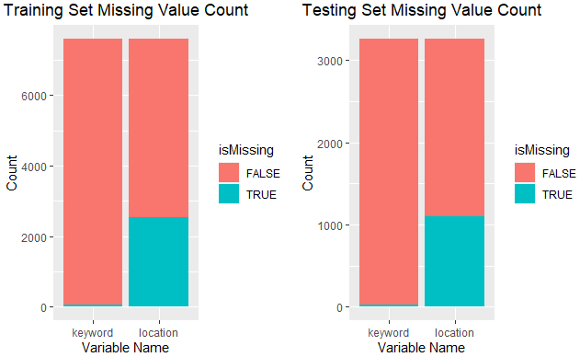
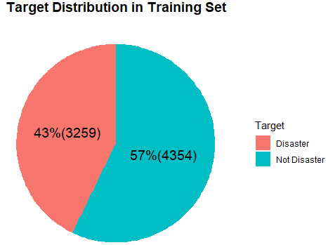
Simple analysis of the dataset
ps: Train-validation split based on target ratio(extract 20% data from trainset as validset)
05

Slide 6
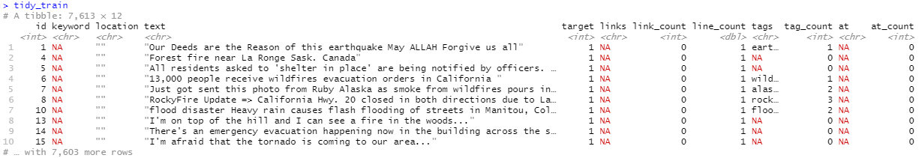
Data Cleaning - text and keyword
Detect and remove mislabeled tweets (36 in trainset, 4 in testset)
Extract links from text
Convert special url character (%20 as white space) to readable string in keyword variable and replace newline character \n in text
Extract Tags and '@'s in text variable
正文内容，本段适应大段文字章节
06

Slide 7
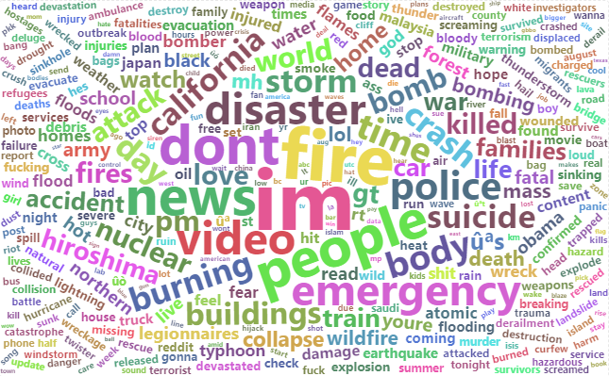
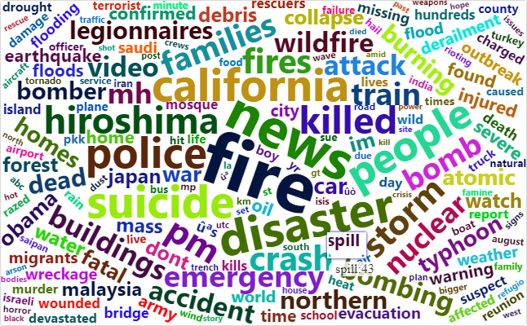
Word Cloud
All text
Disaster text
正文内容，本段适应大段文字章节
07

Slide 8
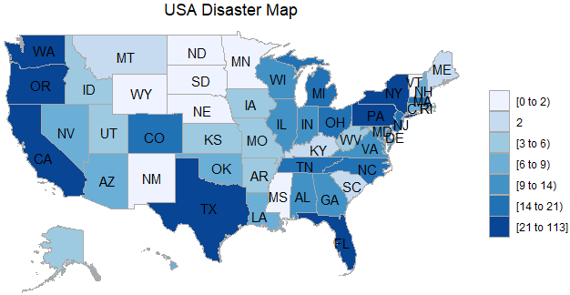
Parse location variable – Situations in American
Since the location variable is irregular, we cleaned it up for visualization:
Cleaned up the *location* variable, filtered out the NA values, and split the location into *location 1* (small address) and *location 2* (large address)
Extract state level data from *location 1* and *location 2* using state.abb and state.name
Calculate the number of occurrences in each state and draw Choropleth maps using choroplethr
08

Slide 9
02
Topic Modeling with LDA

Slide 10
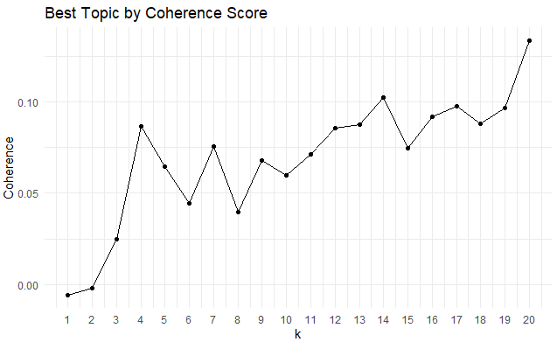
Pre-processing and Model Tuning
01
Tokenization and create the DTM
02
Model Tuning
use algorithm to calculate a coherence score(a score that calculates if the words in the same topic make sense when they are put together), and choose the best topics from 1 to k
Split words in each text, clean unnecessary message, and anti-join with the stop word
convert tokens to DTM with textmineR
10

Slide 11
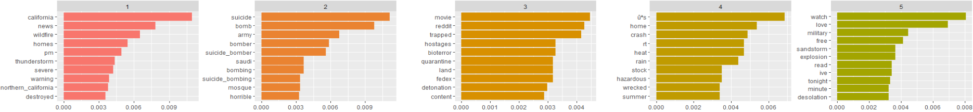
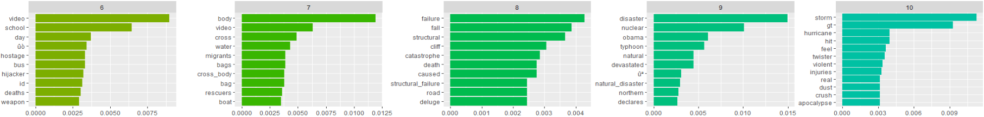
Topics
tweets_lda <- LDA(dtm, k = 20, method="Gibbs")
tweets_topics <- tidy(tweets_lda, matrix = "beta")
California Weather Disasters Suicide Bombing Virus US Stock Market Crisis Sandstorm
正文内容，本段适应大段文字章节
School-bus hijacking Migrant Boat Incident Deluge Disaster Declaration Hurricane
11

Slide 12
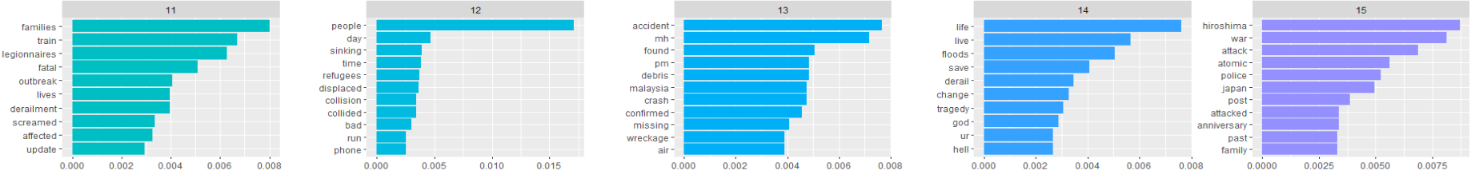
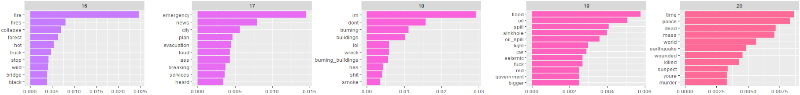
Topics
Legionnaires' disease Land Sinking Missing Malaysia Airlines Flight Floods and Train Derailments Hiroshima Atomic Bomb
正文内容，本段适应大段文字章节
Forest Fires Emergency News Burning Building Oil Spill Mass Shooting
12

Slide 13
03
Feature Engineering
Numeric
Ratio Analysis
Sentimental Analysis
link count
line count
tag count
at count
char length
word count
mean word length
unique word count
punc count
stop word count
disaster keyword count
non disaster keyword count
disaster tag count
non disaster tag count
disaster at count
non disaster at count
disaster unigram count
non disaster unigram count
disaster bigram count
non disaster bigram count
disaster trigram count
non disaster trigram count
sentimental score

Slide 14
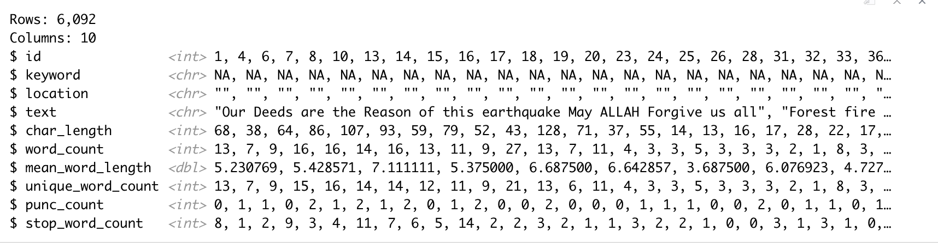
Feature Engineering: Numeric
Extract several features from the text
char length: total number of characters in a tweet
word count：total number of words in a tweet
mean word count: average word length = char_length/word_count
unique word count: total number of distinct words in a tweet
punctuation count: total number of punctuation marks in a tweet
stop words count: total number of stop words in a tweet
正文内容，本段适应大段文字章节
14

Slide 15
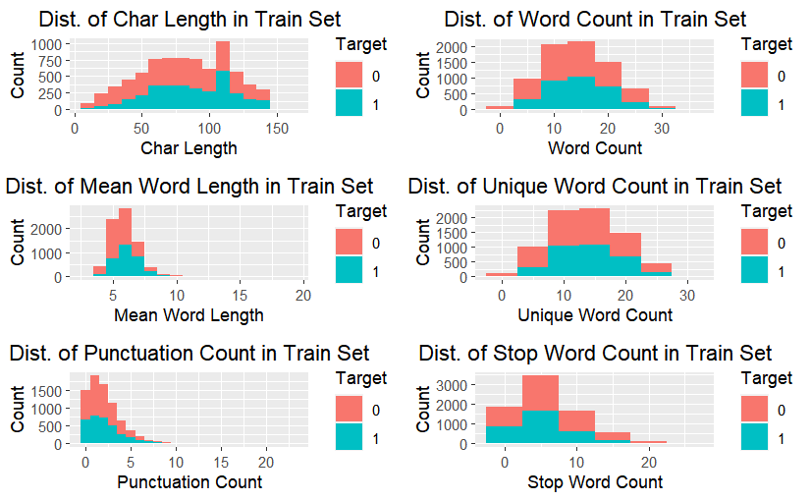
Distribution: Histograms of Each Variable
non-disaster tweets may have
less char length
less mean word length
more unique word count
less punctuation
…
15

Slide 16
Feature Engineering: Ratio Analysis
disaster & non-disaster keyword
disaster & non-disaster tag
Keyword
Determine whether a tweet contains frequent disasters
keyword appearing in tweet
Determine if a tweet contains a tag that often appears in disaster tweets
Tag
disaster & non-disaster n-gram
disaster & non-disaster @
@
Text
Determine if a tweet contains an @ that often appears in disaster tweets
Determine if a tweet contains an n-gram that often appears in disaster tweets
16

Slide 17
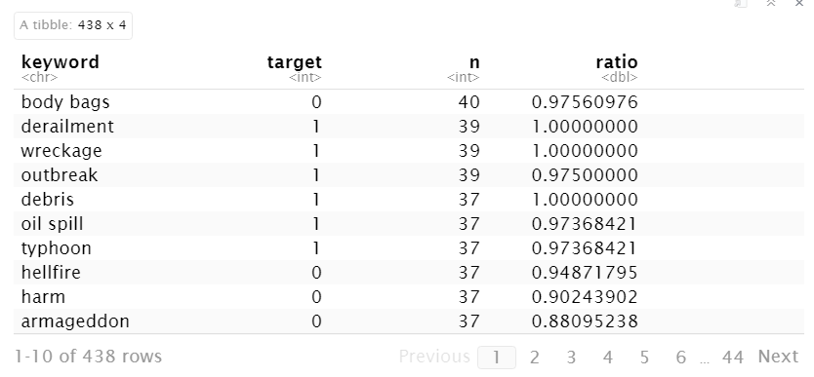
Example : Ratio of keyword
keyword_ratio <- tidy_train %>%
filter(!is.na(keyword)) %>%
group_by(keyword, target) %>%
summarise(n = n()) %>%
mutate(ratio = n / sum(n)) %>%
ungroup() %>%
arrange(desc(n), desc(ratio))
We compute the number and ratio of different keywords appearing in target 1 and target 0 sets
17

Slide 18
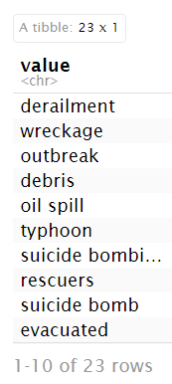
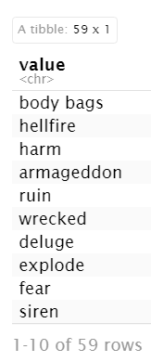
Example: disaster & non-disaster keyword
Disaster Keyword
Non-disaster Keyword
threshold
classification
02
count threshold: 20
ratio threshold: 0.8
If a keyword satisfy the above condition, we decided it was a disaster keyword
If it contains: >0
If not: 0
03
01
Count
Count how many disaster and non-disaster keyword each tweet contains
18

Slide 19
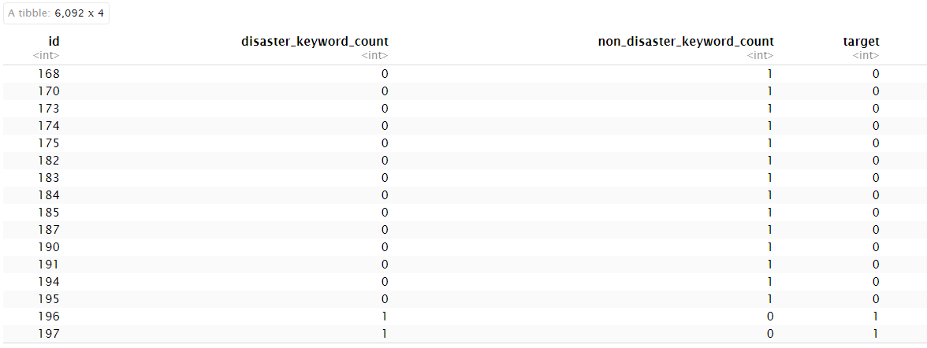
Example: Result
glimpse

Slide 20
Feature Engineering: N-gram analysis
Tokenization
unnest_tokens(unigram, text, token = "ngrams", n = N)
Decompose text into N-word phrases
Clean
N-gram
remove the non-words item
anti-join the stop word to remove stop words
group and sum
group by the n-gram and target
Count the number and ratio of a n-gram
20

Slide 21
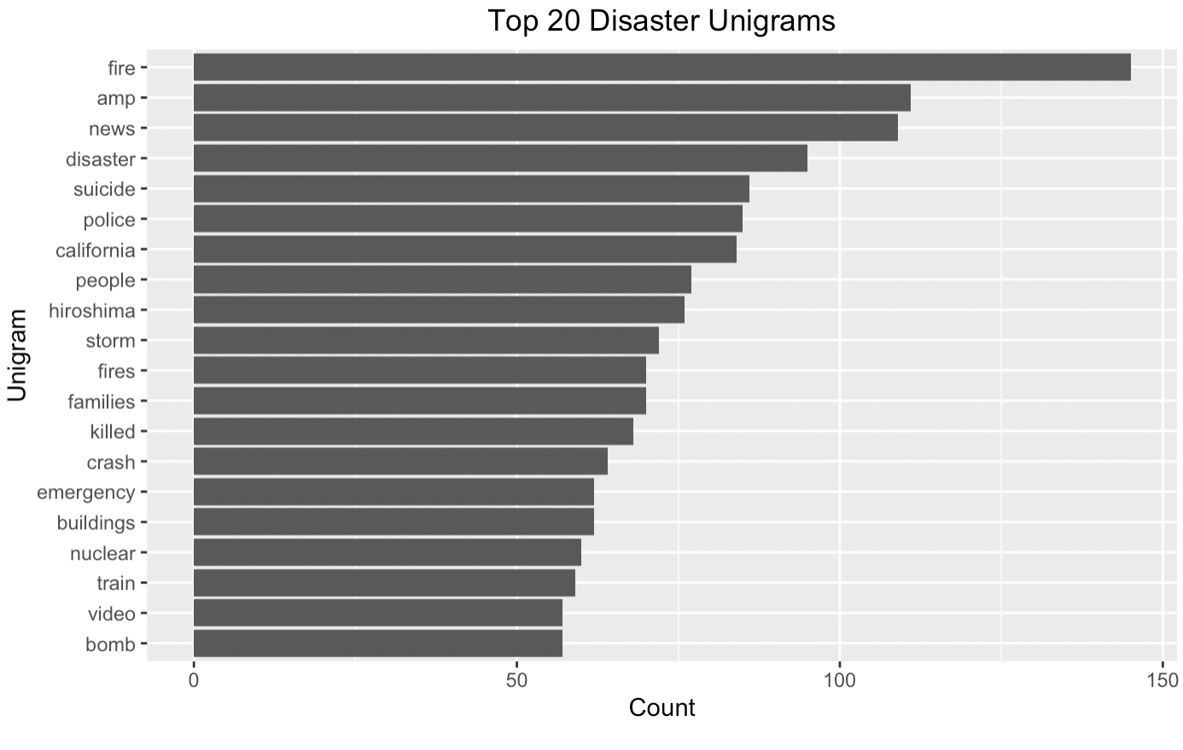
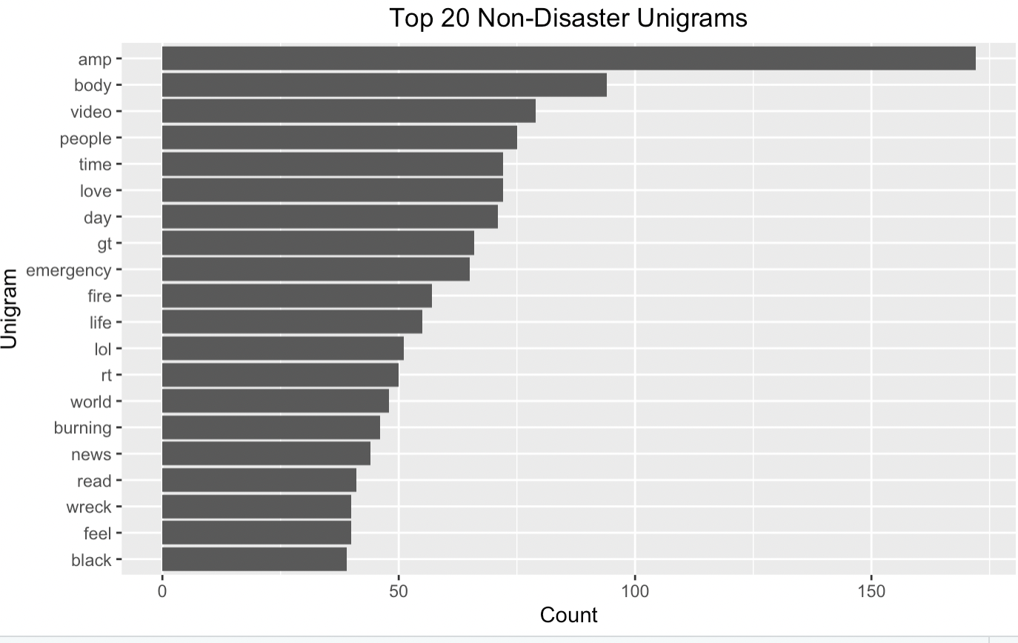
Disaster & Non-disaster Unigrams in Train Set

Slide 22
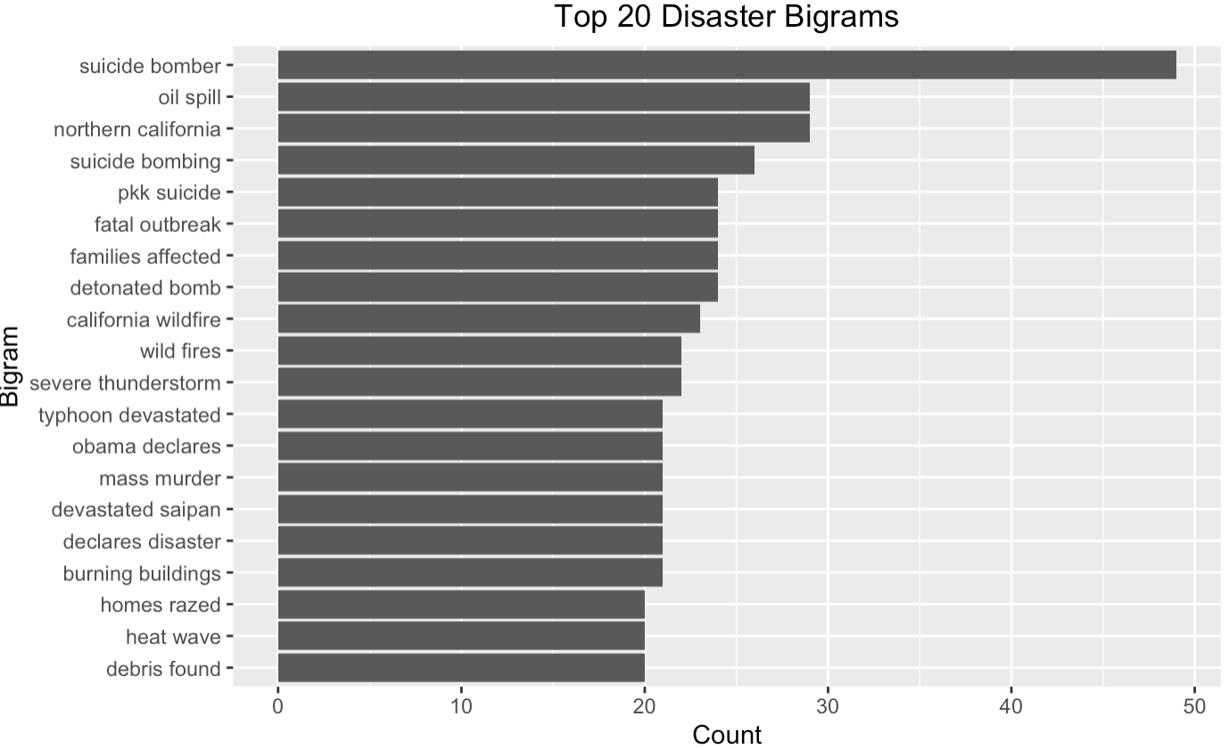
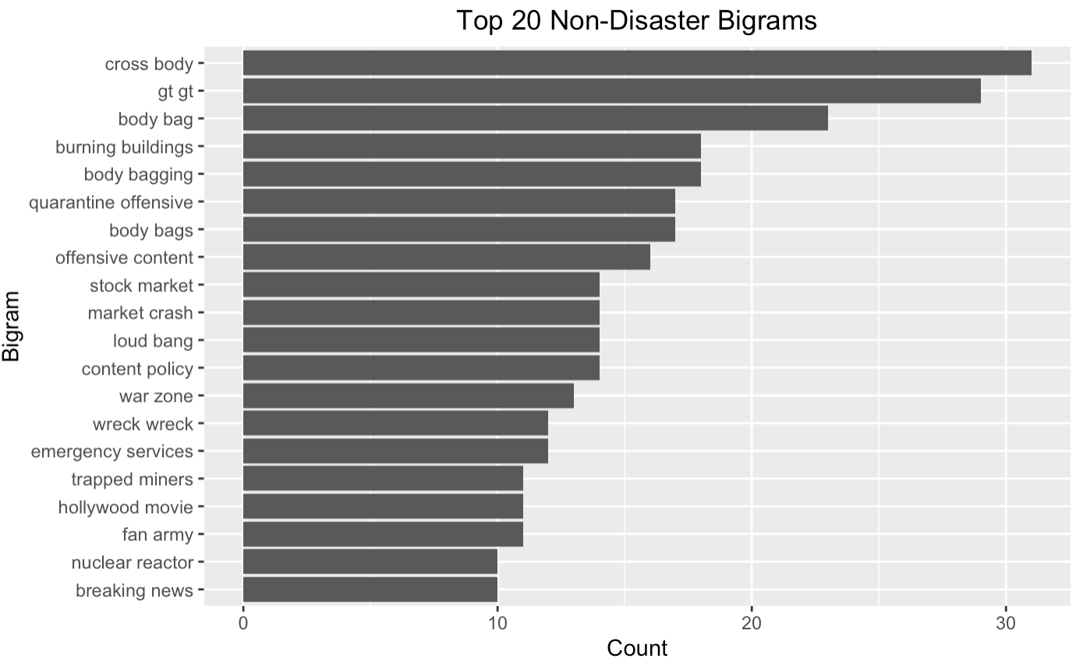
Disaster & Non-disaster Bigrams in Train Set
22

Slide 23
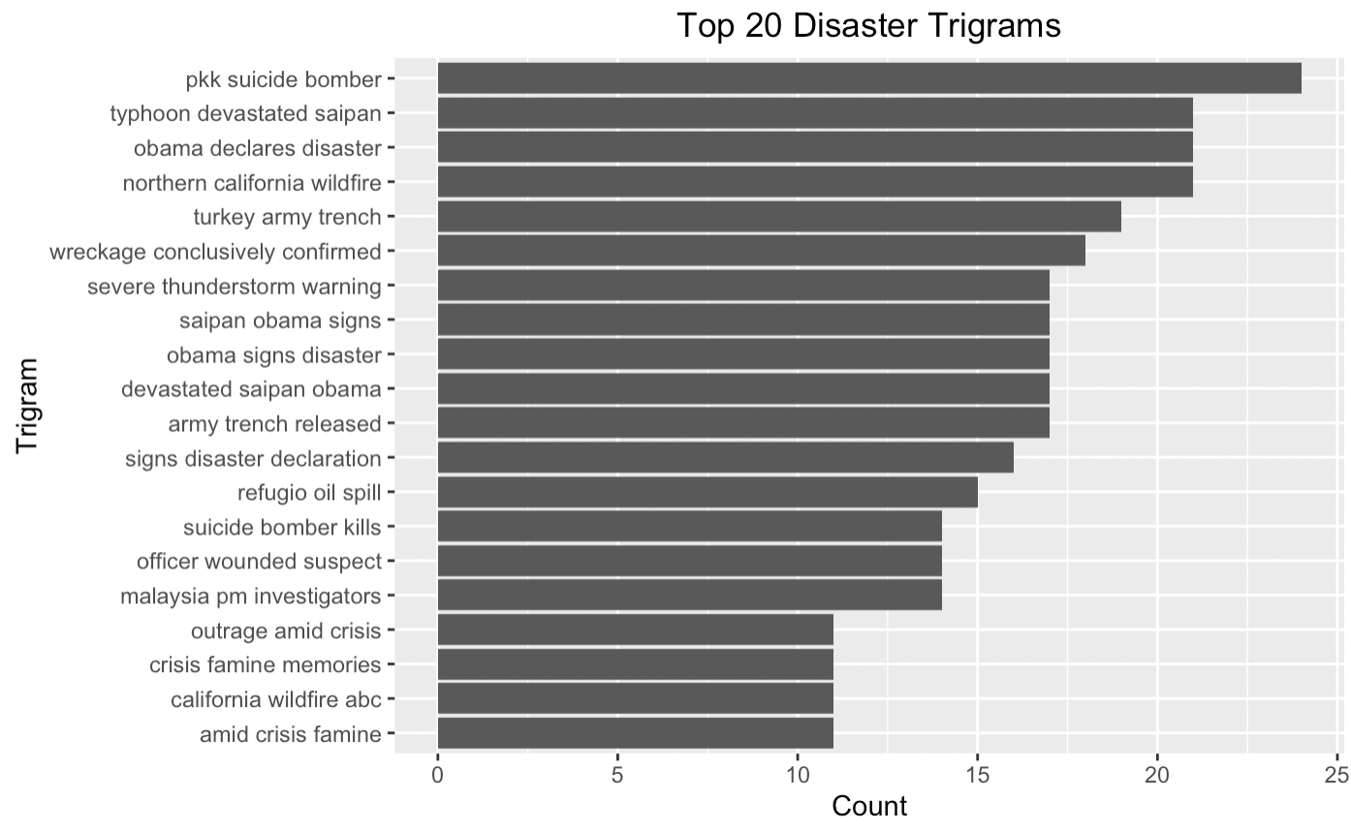
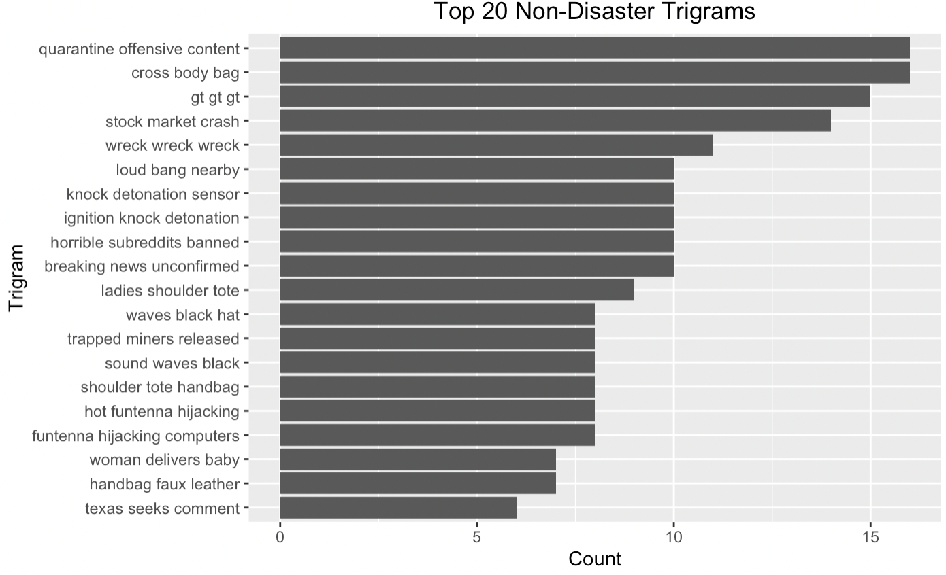
Disaster & Non-disaster Trigrams in Train Set
23

Slide 24
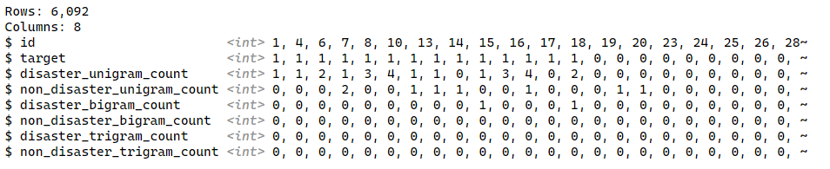
N-gram Result
glimpse
24

Slide 25
03
Sentimental analysis

Slide 26
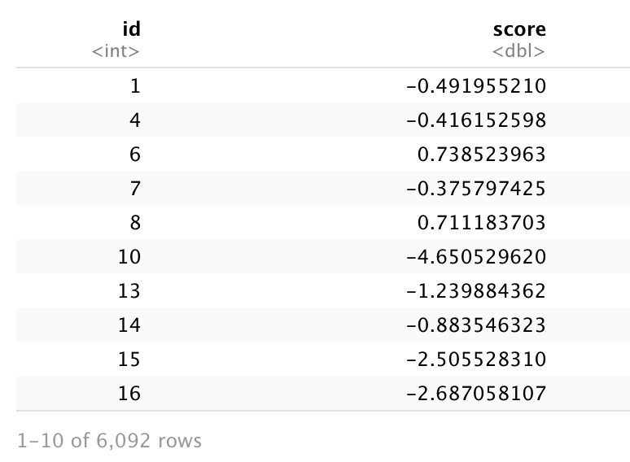
sentimental analysis
NRC-Hashtag-Emotion-Lexicon-v0.2:
https://saifmohammad.com/WebPages/NRC-Emotion-Lexicon.htm
This table assigns each word to eight sentiments, four positive sentiments, and four negative sentiments, and rates the word under each sentiment. Scores range from the -3 to 3
Result table:
Tokenization
2
summing
Split words in each sentence and anti-join with the stop word
group_by the id and get the total score of each sentence
1
3
scoring
left-join the words table with NRC-Hashtag-Emotion-Lexicon-v0.2 to get the score of each word.
26

Slide 27
05
Model training

Slide 28
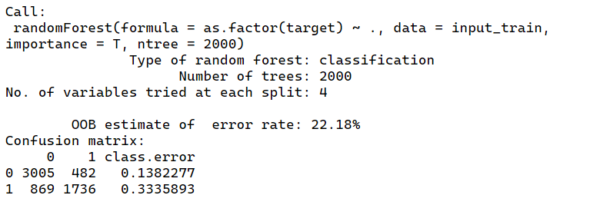
Random forest
Bagging
library(randomForest)
rf <- randomForest(
as.factor(target) ~.,
data = input_train,
importance = T,
ntree = 2000
)
28

Slide 29
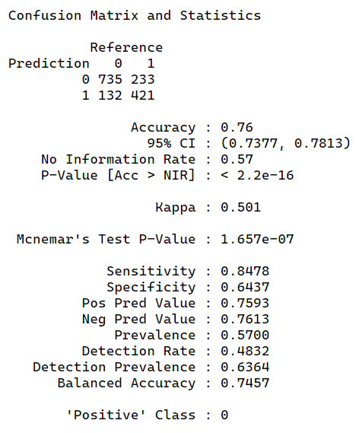
Boosting
Boosting
library(gbm)
boosting <- gbm(
as.character(target) ~.,
data = input_train,,
n.trees = 5000,
distribution = "adaboost",
interaction.depth = 3,
shrinkage = 0.2
)
boosting

Slide 30
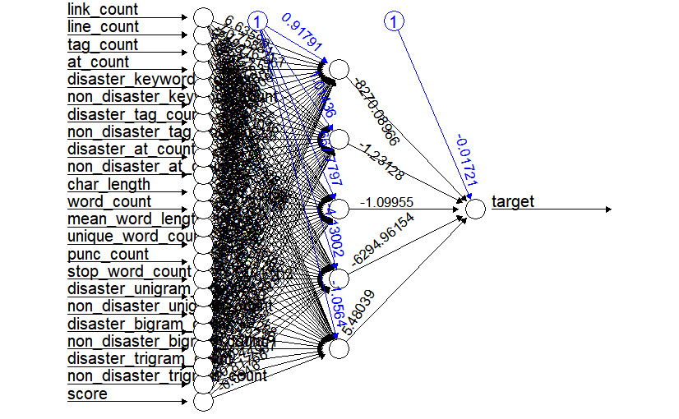
Neural Network Training
result | 0 | 1
0 | 716 | 151
1 | 220 | 434
library(neuralnet)
set.seed(1234)
network <- neuralnet(
target ~
link_count + line_count + tag_count + at_count + disaster_keyword_count +
non_disaster_keyword_count + disaster_tag_count + non_disaster_tag_count +
disaster_at_count + non_disaster_at_count + char_length + word_count + mean_word_length +
unique_word_count + punc_count + stop_word_count + disaster_unigram_count +
non_disaster_unigram_count + disaster_bigram_count +
non_disaster_bigram_count +
disaster_trigram_count +
non_disaster_trigram_count +
score,
data = input_train, rep = 1, hidden = 5, threshold = 0.03,
linear.output = F, lifesign = "full", lifesign.step = 5000,
act.fct = 'logistic',
err.fct = 'ce',
stepmax = 1000000,
likelihood = T
)
30

Slide 31
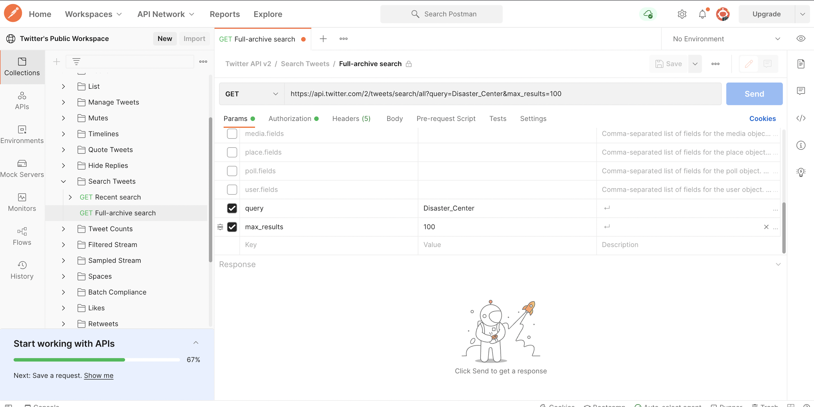
Twitter API
We collected nearly 200 tweets from various disaster and non-disaster Twitter accounts as a test set
31

Slide 32
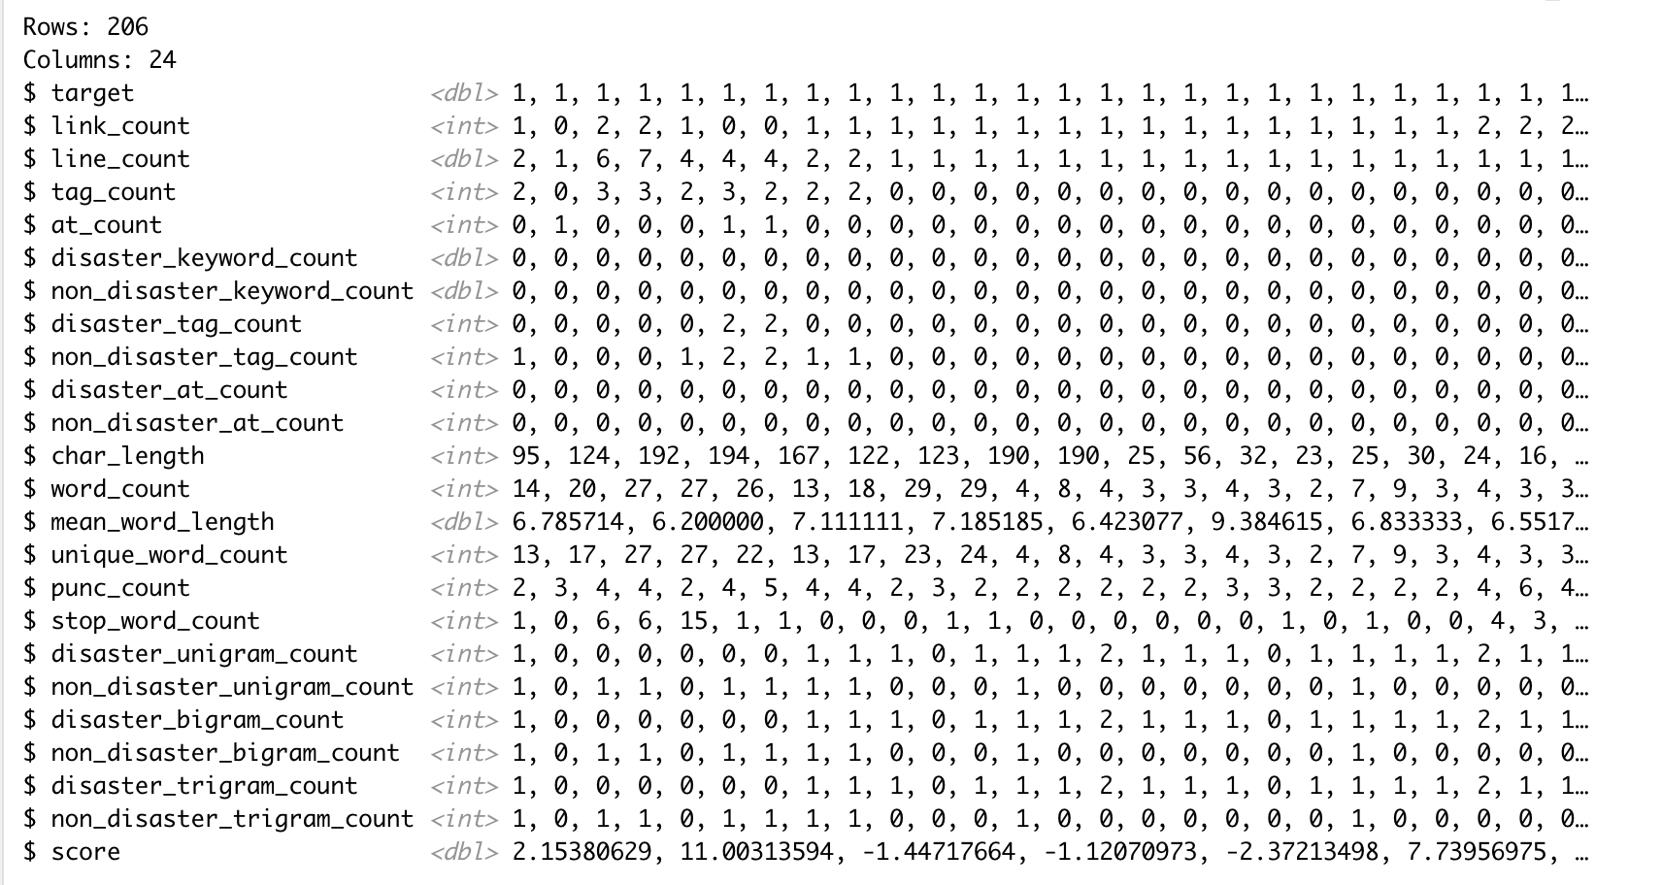
Twitter API
result | 0 | 1
0 | 41 | 65
1 | 26 | 74

Slide 33
Final Project
Thanks for watching
Feiyu Zhang
fz114@scarletmail.rutgers.edu
Junyi LI
jl2707@scarletmail.rutgers.edu
Ziyu Zhou
zz544@scarletmail.rutgers.edu

